Slide 1
Linear Regression
Prof.N.L.Bhanu Murthy

Slide 2
Unbiased Estimators

Slide 3
Unbiased Estimators

Slide 4
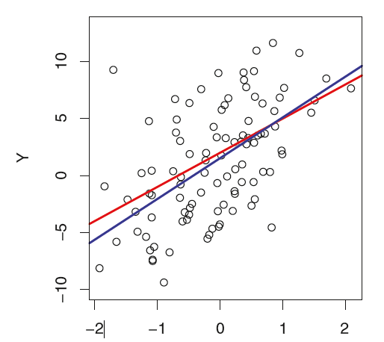
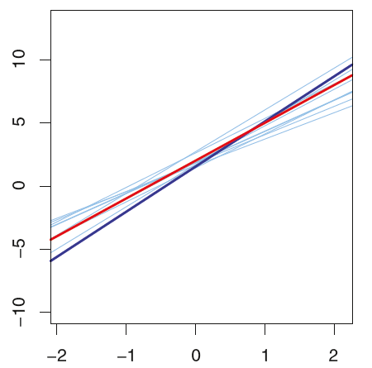
Unbiased Estimators

Slide 5
Unbiased Estimators

Slide 6
Unbiased Estimators

Slide 7
Unbiased Estimators

Slide 8
Thank You!

